Slide 1
Trauma Across the Lifespan:
Big T and Little T Trauma
Robert M Giannamore,
MDiv, MS, NCC, LPC, CPT

Slide 2
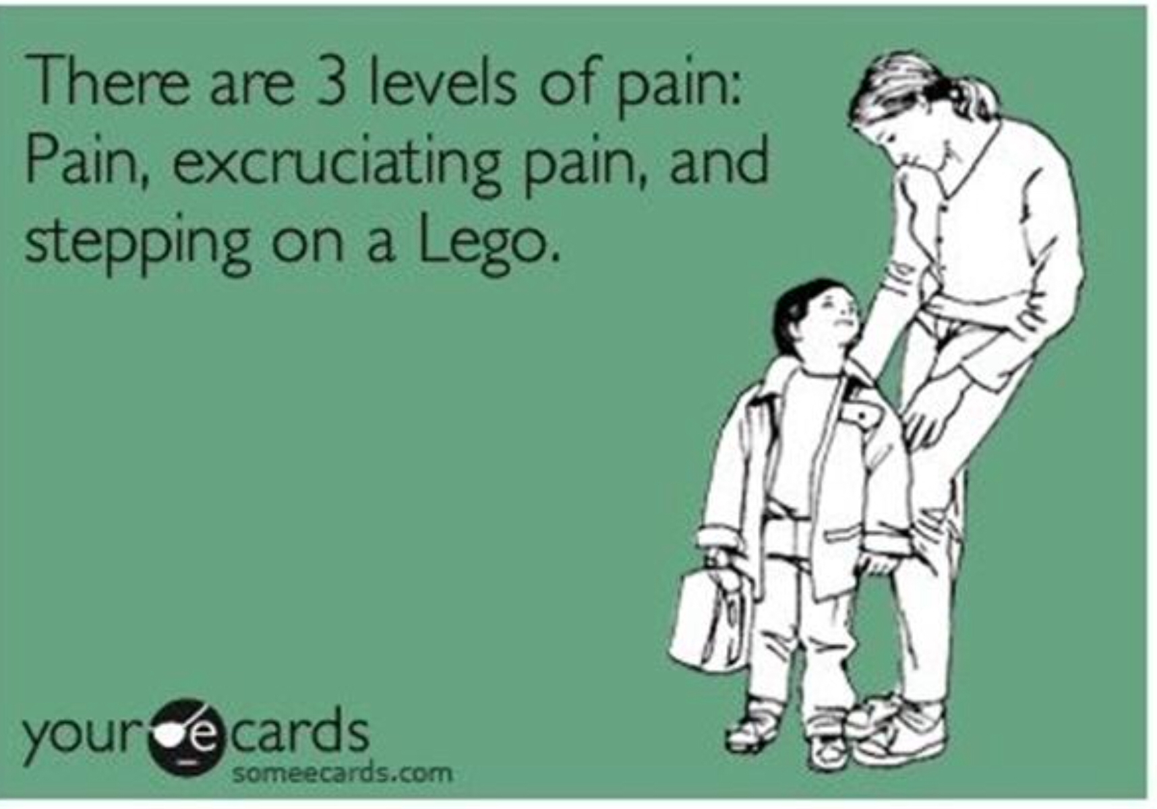

Slide 3
Why?: A functional understanding
L., a 18 year old female was recently admitted to the emergency room because of self-inflicted razor cuts to her wrists, which she claimed made her feel alive by feeling pain. L spent a week in the hospital and was discharged to a Partial Hospitalization program.
During the intake for the Partial Program, L was initially uncooperative stating she felt abandoned by society and especially by her friends and family. L., expressed placing blame on teachers, past therapists and her parents for her inability to reach her dreams of being a model, which she claims contracts to model with various local modeling agencies. She is convinced that one day she will take her life back; however, in the interim, she will have to return to her mother’s home. She is very bitter and angry with both of her parents to whom she feels distance and that her parents owe her an explanation for their failure to support her dreams and ambitions.

Slide 4
Why? : A Functional Understanding
She admitted to the excessive use of anxiolytics and alcohol to control her anxiety and numb the emotional pain. Her presenting complaints consisted to angry outbursts, feelings of emptiness, rejection, loneliness, and depression. She states that she has difficulty getting along with people and experiences rapid mood swings involving depression, anger, and anxiety. She has periods when she feels good about herself and practices self-care. At other times, she finds it impossible to get out of bed and take care of anything. She lacks a sense of identity and doesn’t really know who she is from one minute to the next.
During hospitalization the treatment focused on reduction of the imminent threat to L.’s life and on helping her to develop more effective coping strategies. L. expresses little empathy for others and primarily focuses on immediate gratification of her needs and wants.

Slide 5
Why: A Functional Understanding
L’s ACE load is high with a family history of alcoholism, drug use, abandonment, sexual abuse by an uncle at 6 years old and ending when client stabbed uncle at 14.
Client has a history of 2 abortions and 1 miscarriage. She has never brought a child to term.
L has been involved in several relationships, her last lasted 4 years and was abusive, emotionally, verbally and physically.
Drug use is largely limited to meth and marijuana, Alcohol use is 4 beers a day.
Diet is poor and L is currently 100lbs overweight with markers of pre diabetes, high blood pressure and cholesterol

Slide 6
Why?: A Functional Understanding
L has been discharged to your care in the community clinic setting,
  How would you treat L from the traditional medical model?
  What would an integrated medical approach look at for L?
What assumptions do you have?
What is the function of L’s behavior?
What is the emotional age of L?

Slide 7
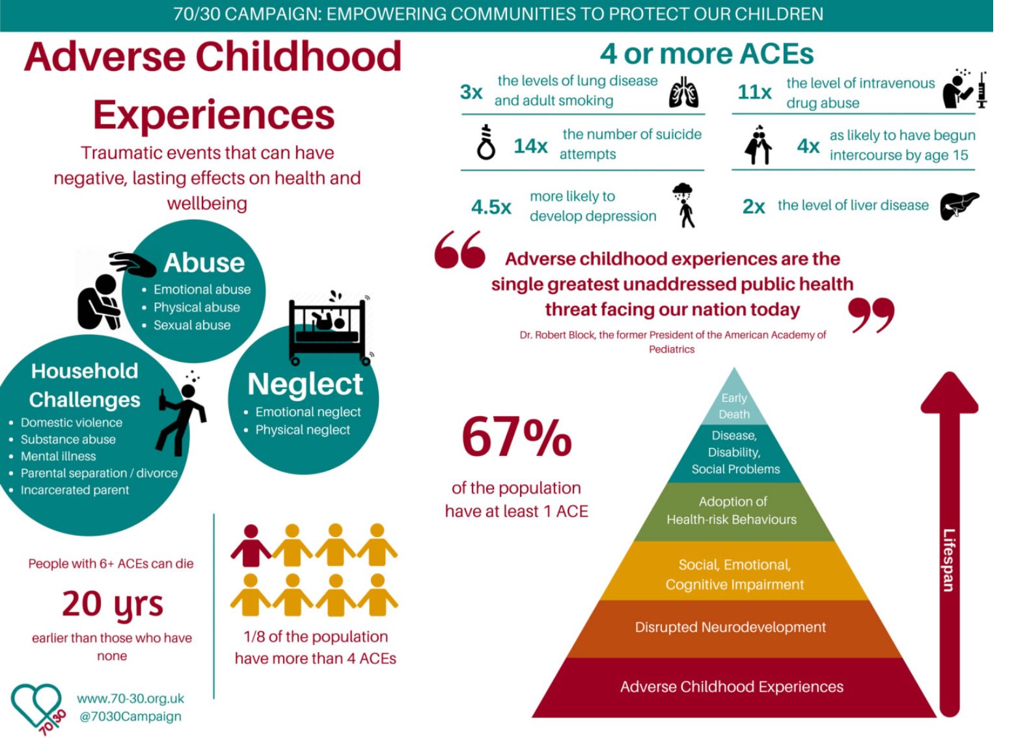
ACEs Study

Slide 8
ACE’s Study: What is it?
The CDC-Kaiser Permanente Adverse Childhood Experiences (ACE) Study is one of the largest investigations of childhood abuse and neglect and household challenges and later-life health and well-being.The original ACE Study was conducted at Kaiser Permanente from 1995 to 1997 with two waves of data collection. Over 17,000 Health Maintenance Organization members from Southern California receiving physical exams completed confidential surveys regarding their childhood experiences and current health status and behaviors. (CDC, n.d.)

Slide 9
ACE’s Brief Run Down
Zare, Narayan, Lasway, Kitsantas, Wojtusiak, and Oetjen demonstrated in a data analysis of 31,060 primary school-aged children was extracted from the nationally representative sample of 95,677 children 0 to 17 years old.
Their findings showed “that in this sample, 6% of children were diagnosed with depression and/or anxiety. Findings also showed that economic hardship, poor parental mental/behavioral health, exposure to violence, or racial/ethnic discrimination increased the risk of depression and/or anxiety in 6- to 11-year-old children. Pediatric nurses can help protect children from adverse childhood experience exposure and can help them recover from these events. Pediatric nurses can identify children at risk, provide parental anticipatory guidance, make referrals for mental health services and community-based programs, protect children from traumatic medical events, and provide resilience education/ skill-building, which can alleviate the long-term effects of adverse childhood experiences exposure”(Zare, M., Narayan, M., Lasway, A., Kitsantas, P., Wojtusiak, J., & Oetjen, C. A. 2018).

Slide 10
Children grow up to be adults:What does the research say for adults exposed to ACE’s?
Reuben, A., Moffitt, T. E., Caspi, A., Belsky, D. W., Harrington, H., Schroeder, F., looking at retrospective and prospective recollection, demonstrated that clients who experienced adversity whether recalled or not had greater risk of that poor physical and cognitive health at midlife.
Furthermore, they show that “psychological resilience to adversity thus may not confer physiological resilience and primary care clinics using retrospective ACE reports to screen for high-risk patients may overlook individuals at risk from ACEs that they experienced but do not remember. Meanwhile, the strong association between recalled adversity and self-rated health and social outcomes suggests a bias of both under- and over reporting”
They conclude that their ”study confirms that the maltreatment and deprivation of the child holds implications for the adult. However, an individual’s perception of the past and present, accurate or not, plays a role as well, potentially influencing both prophesies of risk and their fulfillment”(Reuben, Moffitt, Caspi, Belsky, Harrington, and Schroeder, 2016).

Slide 11
ACE’s and Adulthood impact, cont.
Karatekin in a study published in 2018 of 239 students in a “large Mid West University” found that “ACEs predicted worsening of mental health over the course of a semester and suggested current number of stressors as a mediator of the relationship between ACEs and mental health. Results suggest that screening for ACEs might be useful to identify students at high risk for deterioration in mental health. Results further suggest that stress‐related interventions would be beneficial for students with high levels of ACEs and point to the need for more research and strategies to increase help‐seeking in college students”(Karatekin, 2018)

Slide 12
ACE’s : Prevention
https://m.youtube.com/watch?v=d-SSwYTe8TY (CDC, 2018)
Take a moment now in your groups to discuss what you can begin to do to mitigate the impact of ACE’s in your patient population.
If there is a mental health aspect to ACE’s, what are the preventative physiological diseases that can arise from untreated mental health problems?

Slide 13
Trauma and Stress Related Disorders
Reactive Attachment Disorder
  RAD- an emotionally withdrawn/inhibited phenotype
Emotionally withdrawn
Social/emotional disturbance - reduced responsiveness, limited affect &/or irritability, sadness or fearfulness
Exposure to extremes of insufficient care – social neglect/deprivation, repeated caregivers, rearing in unusual settings(Albaugh, 2013)
Disinhibited Social Engagement Disorder(DSED)
  DSED – an indiscriminately social/disinhibited phenotype
Reduced/absent reticence when interacting with unfamiliar adults
Behaviors not limited to impulsivity but include socially disinhibited behavior
Exposure to extremes of insufficient care – social neglect/deprivation, repeated changes in caregivers, rearing in unusual settings(Albaugh, 2013)

Slide 14
Trauma and Stress Related Disorders
PTSD
Acute Stress Disorder
Other specified trauma- and stressor-related disorder
Unspecified trauma- and stressor-related disorder
Anxiety –note anxiety disorders were linked to trauma disorders, however, Stress Disorders are now considered distinct because many patients do not have anxiety but instead have symptoms of anhedonia or dysphoria, anger, aggression, or dissociation
Depression
In this LPC’s experience, Axis II presentations

Slide 15
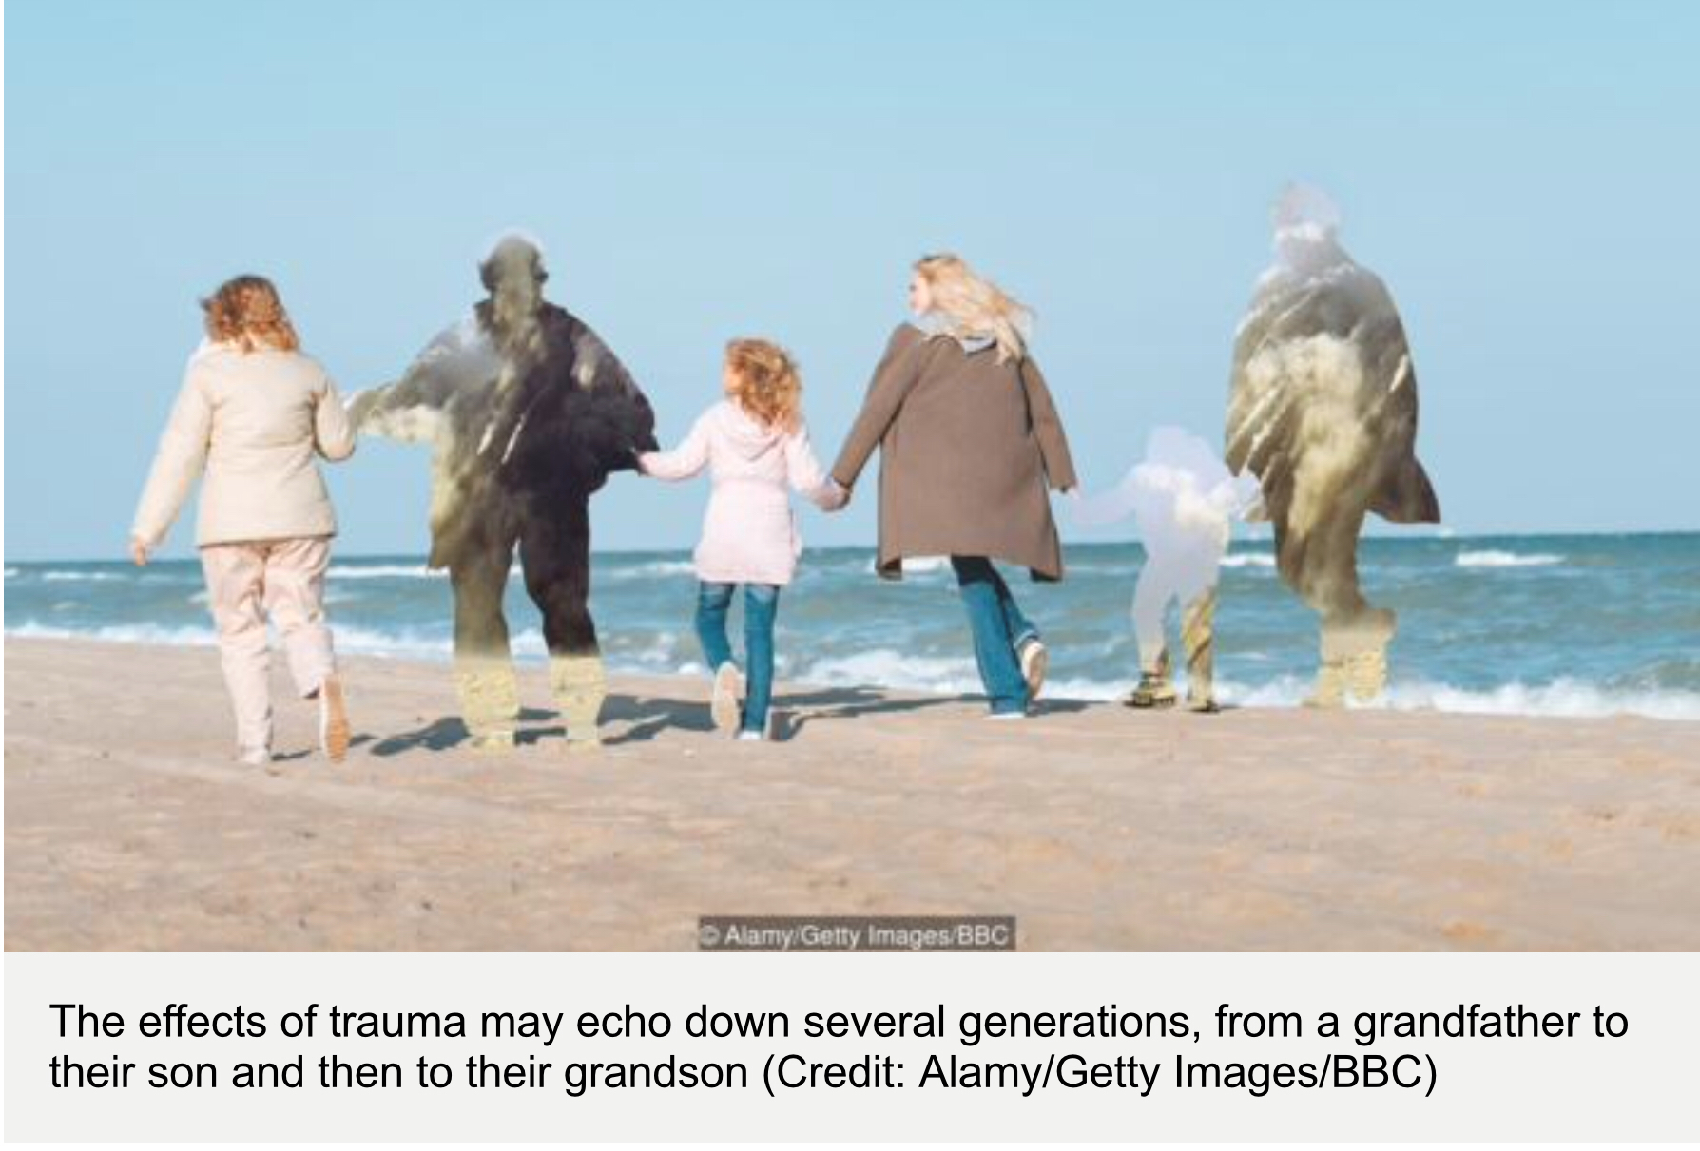
Inter Generational Trauma – Epigenitics
https://youtu.be/3e8-Xr2SPY4
(Henriques,
2019)

Slide 16
Epigenetics
Ancestral stress Alters Lifetime Mental Health trajectories and Cortical Neuromorphology via epigenetic Regulation
This is an article published online in April of 2019 from the Journal Nature. This report is one of many found online highlighting how adverse experiences from your ancestors past can leave markers on your DNA that can directly relate to your expression of mental health concerns. It supports work by other researchers like Yehuda who show that trans generational stress can create anxiety like symptoms in post generations.

Slide 17
Epigenetics, continued

Slide 18

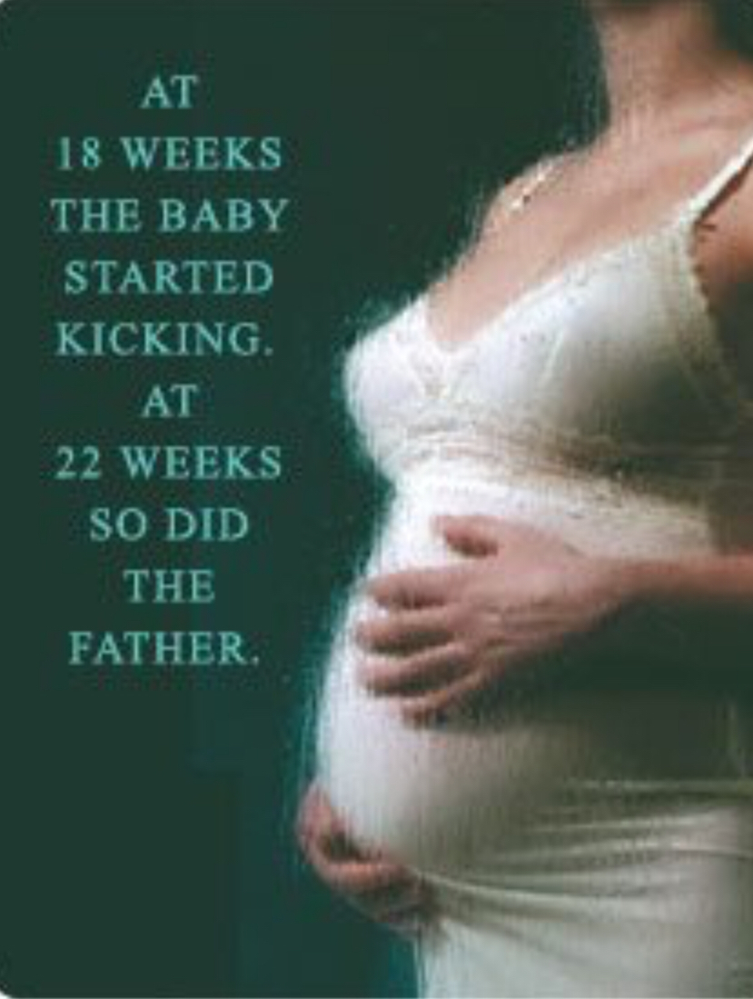
Two views of pregnancy

Slide 19
In the previous slide, you saw two sides of pregnancy,
What expectations would you have in your patients who were experiencing the “Glow” of a healthy “normal” pregnancy?
What expectations would have from a patient presenting with an abusive background? What assumptions would you have?

Slide 20
Prenatal Stress
In a summary for the Cognitive Neuroscience Society, they offer
“The time babies spend in the womb is far from idle. The brain is changing more rapidly during this time than at any other time in development. It is an active time for the fetus to grow and explore, and of course connect to its mother. New evidence from in-utero fetal brain scans shows, for the first time, that this connection directly affects brain development” (Cognitive Neuroscience Society, 2018)

Slide 21
Prenatal Stress
In utero, babies are aware of sounds from their mothers and environments around them. Also, we know babies are susceptible to the mother’s use of alcohol, drugs, and even the violent and stressful nature the mother is surrounded in through the cortisol dump brought on from the mother’s production of the hormone.

Slide 22
Prenatal Stress
In the Journal of Endocrinology, supporting the statement of the previous slide, researchers show that “During critical periods in pregnancy, the fetus has a heightened susceptibility to prenatal maternal stress (PNMS). Animal research shows that PNMS is associated with altered development of fetal neurobiological systems, particularly the central nervous system (CNS) and the hypothalamic-pituitary-adrenal (HPA) axis, which subsequently leads to impairment of health, cognition, affect and behavior. Human population studies also have demonstrated associations between PNMS, fetal CNS, HPA axis development, and offspring long-term neurobehavioral and neurodevelopmental aberrations”(Zhang W, et al, 2018).

Slide 23
Prenatal Stress
In Zhang’s research, during Superstorm Sandy, the outcome suggest that trauma exposure may uniquely impact developmental processes through changes in expression of genes which foster distinct developmental processes. Furthermore, it is likely that some of the genes Zhang and colleagues identified are fully developed and begin functioning during early pregnancy, whereas others only begin functioning during mid-late pregnancy. Although we were able to identify changes in gene expression as a result of placental development, the underlying molecular mechanisms by which this occurs requires further exploration; thus, replication is needed. Expression of placental genes likely varies across gestation to accommodate the dynamically changing needs of the developing fetus, although the molecular basis of placental development has yet to be fully uncovered. Zhang and colleagues findings suggest that several genes may be more vulnerable to maternal trauma exposure depending on the timing of exposure during gestation. (Zhang W, et al., 2018)

Slide 24
Prenatal Stress
In a review of 32 studies that focused on pregnancy-related anxiety, state or trait anxiety, perceived stress, and stressful life events in relation to child's crying, temperament, or behavior during the first 2 years of life, it was determined that there was an association between maternal prenatal anxiety and stress and the child’s ”negative reactivity or self-regulation, and typically the effect sizes varied from low to moderate. The association was found regardless of the form of prenatal stress or anxiety and the trimester in which the prenatal stress or anxiety was measured. In conclusion, several forms of prenatal anxiety and stress may increase the risk of emotional and self-regulatory difficulties during the first 2 years of life”. (Korja, Riikka, Nolvi, Saara, Grant, Kerry,McMahon, Cathy,Grant, Kerry Ann,2017)

Slide 25
Attachment and Trauma
“The greatest source of danger and unpredictability is the absence of a caregiver who reliably and responsibly protects and nurtures the child”(Albaugh, 2013)
“Children exposed to complex trauma are unable to devote resources normally to growth and development, but instead their focus is on survival”(Albaugh, 2013).

Slide 26
Complex Trauma
Complex trauma describes both children’s exposure to multiple traumatic events—often of an invasive, interpersonal nature—and the wide-ranging, long-term effects of this exposure. These events are severe and pervasive, such as abuse or profound neglect. They usually occur early in life and can disrupt many aspects of the child’s development and the formation of a sense of self. Since these events often occur with a caregiver, they interfere with the child’s ability to form a secure attachment. Many aspects of a child’s healthy physical and mental development rely on this primary source of safety and stability (National Child Traumatic Stress Network, 2019)

Slide 27
Complex Trauma
Impacts 8 domains (https://www.nctsn.org/what-is-child-trauma/trauma-types/complex-trauma/effects
Attachment
Biology
Affect Regulation
Dissociation
Behavioral Regulation
Cognition
Self Concept
Family Context

Slide 28
Complex Trauma: What to Expect?
Attachment Disruption
As an infant, the job for this child is to form internal representations that are organized around Trust, Security and Wellbeing. This time period ranges from 9 months to 5 years, when the child enters school and begins to test out these internal concepts externally with their first exposure to another organized social environment.

Slide 29
Questions for Infant/Preschooler in beginning to understand their sense of self:
Will my signals of need and distress be understood and responded to?
What kind of responses can I anticipate?
Will I feel better worse as a result of the response I get?
Which of the many signals I give get attention?
Is it the kind of attention I want?
(Albaugh quoting Liberman and Zeanah, 2013)

Slide 30
“Attachment is the deep and enduring connection established between a child and caregiver in the first several years of life”(Albaugh quoting Levy and Orlans, 2013)
“Attachment refers to the dimensions of the INFANT – CAREGIVER RELATIONSHIP involving protection and securing regulation”
Attachment in this framework is “conceptualized as an intense and enduring bond that the infant develops s with the mother figure, a bond that is biological rooted in the function of protection from danger.” (Albaugh quoting John Bowlby and Liberman and Zeanah, 2013).
The child’s attachment systems operates in a system that provides the child with conditions necessary for survival and development (Albaugh, 2013)

Slide 31
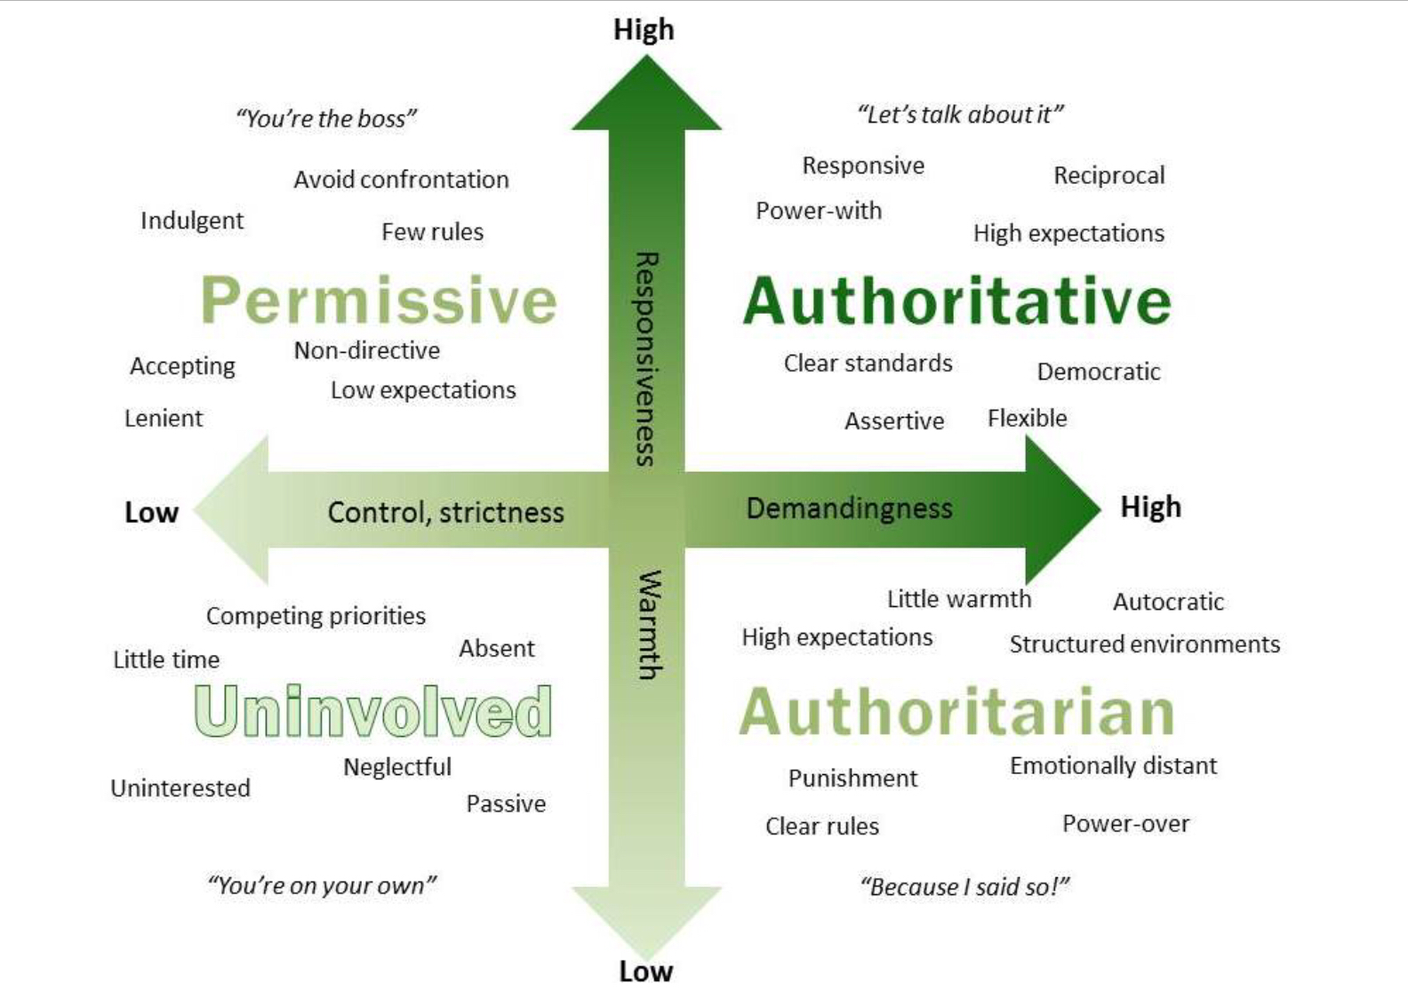

Slide 32
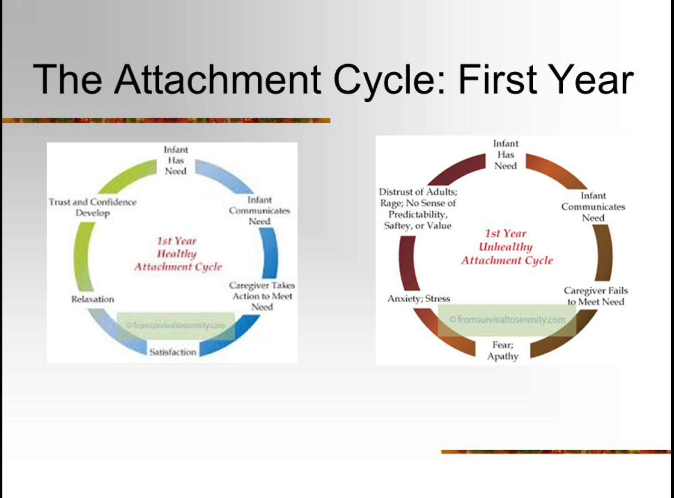

Slide 33
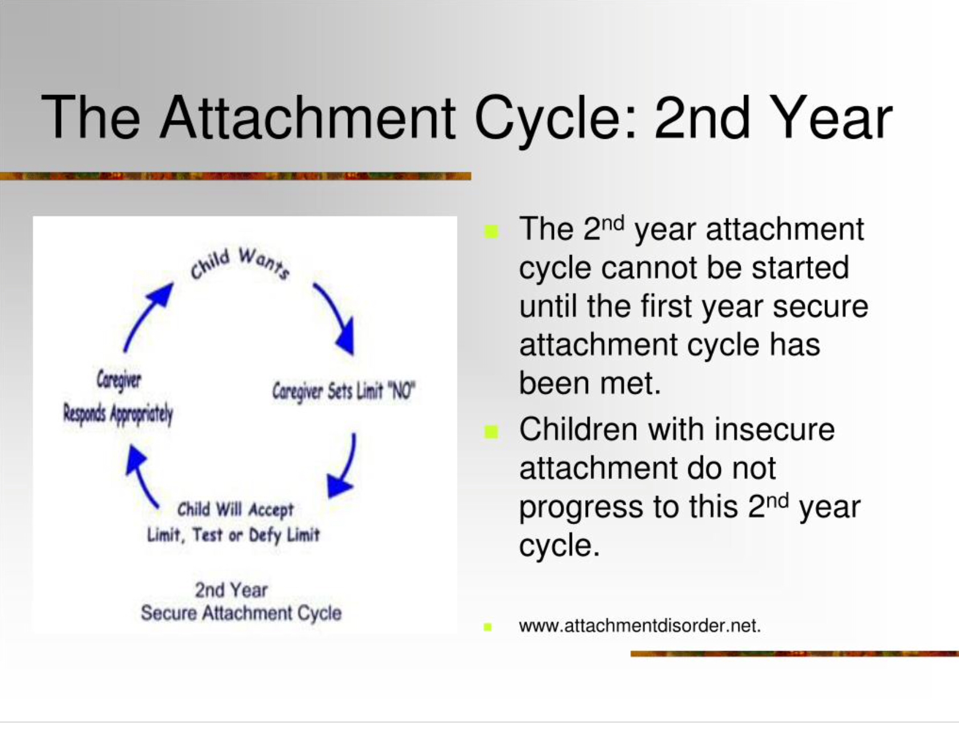

Slide 34
Attachments: Types
Secure
Anxious – preoccupied
Dismissive – Avoidant
Fearful – Avoidant
Disruptive attachments show an inability to trust, inability to connect, unstable moods and emotional numbness.

Slide 35
Attachment and Trauma
During Bowlby’s work on attachment, he and his colleague Colin Murray Parkes noticed four stages of grief:
Shock and Numbness: In this initial phase, the bereaved may feel that the loss is not real, or that it is simply impossible to accept. He or she may experience physical distress and will be unable to understand and communicate his or her emotions.
Yearning and Searching: In this phase, the bereaved is very aware of the void in his or her life and may try to fill that void with something or someone else. He or she still identifies strongly and may be preoccupied with the deceased.
Despair and Disorganization: The bereaved now accepts that things have changed and cannot go back to the way they were before. He or she may also experience despair, hopelessness, and anger, as well as questioning and an intense focus on making sense of the situation. He or she might withdraw from others in this phase.
Reorganization and Recovery: In the final phase, the bereaved person’s faith in life may start to come back. He or she will start to rebuild and establish new goals, new patterns, and new habits in life. The bereaved will begin to trust again, and grief will recede to the back of his or her mind instead of staying front and center (Williams & Haley, 2017)(Ackerman, 2018)

Slide 36
Attachment and Trauma
Turn to your table mates and discuss how you see these stages of grief unresolved in your patients?
How have these steps manifested themselves into the behavioral, psychological and physiological problems you experience daily?

Slide 37
Symptoms of Attachment Disorder
Superficially engaging and charming child
Indiscriminately affection with strangers
Lack of affection with parents on their terms(not cuddly)
Persistent nonsense questions and incessant chatter
Inappropriate demanding and clingy behavior(Albaugh, 2013)

Slide 38
Symptoms of Attachment Disorder
Lying about the obvious
Stealing
Destructive behavior to self, others and to material things(accident prone)
Abnormal eating patterns
No impulse control(Frequently act hyperactive/ hyper - vigilant(Albaugh, 2013)

Slide 39
Symptoms of Attachment Disorder
Lags in learning
Abnormal Speech patterns
Poor peer relationships
Lack of cause and effect thinking
Lack of conscience
Cruelty to animals
Preoccupation with fire (Albaugh, 2013)

Slide 40
Who do this symptoms fit? - what are your war stories?

Slide 41
Nutrition and Trauma
Disclaimer – I am not a nutritionist, none of this information is to be construed as nutritional/ medical advice.

Slide 42
Nutrition and Trauma
A review of literature demonstrates that there is a link between trauma it’s impact on our gut health. Studies point to irritable bowel syndrome and changes to Neuropeptide Y expression.

Slide 43
Adverse childhood experiences are associated with irritable bowel syndrome and gastrointestinal symptom severity
“Early adverse life events (EALs) are associated with irritable bowel syndrome (IBS). Expo- sure to EALs as assessed by the Adverse Childhood Experiences (ACE) questionnaire is associated with greater disease prevalence, but ACE has not been studied in gastrointestinal disorders. Study aims were to: (i) Estimate the prevalence of EALs in the IBS patients using the ACE questionnaire; (ii) Determine correlations between ACE and Early Trauma Inventory Self Report-Short Form (ETI-SR) scores to confirm its validity in IBS; and (iii) Correlate ACE scores with IBS symptom severity”(Park, S. H., Videlock, E. J., Shih, W., Presson, A. P., Mayer, E. A., & Chang, L., 2016)

Slide 44
Adverse childhood experiences are associated with irritable bowel syndrome and gastrointestinal symptom severity – Results of Study
Subjects included 148 Rome III positive IBS patients (73% women) and 154 Healthy Controls(HCs) (59% women). Compared to HCs, IBS patients were comprised of more women, had a lower body mass index (BMI), and had higher scores for Hospital Anxiety and Depression scale(HAD) anxiety and depression symptoms, and somatic symptom severity. For HAD anxiety, 75% of IBS patients and 100% of HCs were in the normal range (0–10), and for HAD depression, 96% of IBS patients and 99.4% of HCs were in the normal range (Park, et al., 2016).
In IBS, we found that a history of household mental illness, incarcerated household member and emotional abuse were notable predictors of IBS. The ACE questionnaire is a useful instrument to measure Early Adverse Life Events(EALs) in IBS based on its use in large studies, its ability to measure prevalence across different EAL domains, and its correlation with IBS symptom severity (Park, et al., 2016).
In Sum, when treating IBS and other bowel issues, therapy appears to be a good tool to aid recovery.

Slide 45
References
Ackerman, C. (2018, April 27). What is Attachment Theory? Bowlby's 4 Stages Explained. Retrieved from https://positivepsyhology.com/attachment-theory/Specific quote came from: Williams, L., & Haley, E. (2017). Before the five stages were the FOUR stages of grief. Retrieved from https://whatsyourgrief.com/bowlby-four-stages-of-grief/
Albaugh, M. (2013). Attachment Workshop. Lecture presented in Perseus House, Erie.
Ambeskovic, M., Babenko, O., Ilnytskyy, T., Kovalchuk, I., Kolb, B., & Metz, G. (2019). Supplemental Information 2: NCBI genome database accession information (PDF file). Nature, 9(6389). doi:10.7717/peerj.6447/supp-2
Centers for Disease Control and Prevention (CDC). (2018, June 26). Retrieved June 19, 2019, from https://m.youtube.com/watch?v=d-SSwYTe8TY
About the CDC-Kaiser ACE Study |Violence Prevention|Injury Center|CDC. (n.d.). Retrieved June 19, 2019, from https://www.cdc.gov/violenceprevention/childabuseandneglect/acestudy/about.html
Cognitive Neuroscience Society. (2018, March 26). Prenatal stress changes brain connectivity in-utero: New findings from developmental cognitive neuroscience. ScienceDaily. Retrieved June 17, 2019 from www.sciencedaily.com/releases/2018/03/180326110123.htm
Complex Trauma in Children and Adolescents. (2019). National Child Traumatic Stress Network. www.NCTSNet.org

Slide 46
References
Henriques, M. (2019, March 26). Future - Can the legacy of trauma be passed down the generations? Retrieved from http://www.bbc.com/future/story/20190326-what-is-epigenetics
Korja, R., Nolvi, S., Grant, K., McMahon, C., & Grant, K. A. (2017). The Relations Between Maternal Prenatal Anxiety or Stress and Child’s Early Negative Reactivity or Self-Regulation: A Systematic Review. Child Psychiatry & Human Development, 48(6), 851–869. https://doi.org/10.1007/s10578-017-0709-0
Karatekin, C. (2018). Adverse Childhood Experiences (ACEs), Stress and Mental Health in College Students. Stress & Health: Journal of the International Society for the Investigation of Stress, 34(1), 36–45. https://doi.org/10.1002/smi.2761
Park, S. H., Videlock, E. J., Shih, W., Presson, A. P., Mayer, E. A., & Chang, L. (2016). Adverse childhood experiences are associated with irritable bowel syndrome and gastrointestinal symptom severity. Neurogastroenterology & Motility, 28(8), 1252–1260. https://doi.org/10.1111/nmo.12826

Slide 47
References
Reuben, A., Moffitt, T. E., Caspi, A., Belsky, D. W., Harrington, H., Schroeder, F., … Danese, A. (2016). Lest we forget: comparing retrospective and prospective assessments of adverse childhood experiences in the prediction of adult health. Journal of Child Psychology & Psychiatry, 57(10), 1103–1112. https://doi.org/10.1111/jcpp.12621
YouTube, 6 Sept. 2015, youtu.be/3e8-Xr2SPY4.
Stam, R., Akkermans, L. M., & Wiegant, V. M. (1997). Trauma and the gut: Interactions between stressful experience and intestinal function. Gut, 40(6), 704-709. doi:10.1136/gut.40.6.704. Retrieved from https://www.ncbi.nlm.nih.gov/pmc/articles/PMC1027192/pdf/gut00039-0018.pdf
Zhang, W., Li, Q., Deyssenroth, M., Lambertini, L., Finik, J., Ham, J., … Nomura, Y. (2018). Timing of prenatal exposure to trauma and altered placental expressions of hypothalamic‐pituitary‐adrenal axis genes and genes driving neurodevelopment. Journal of Neuroendocrinology, 30(4), 1. https://doi.org/10.1111/jne.12581
Zare, M., Narayan, M., Lasway, A., Kitsantas, P., Wojtusiak, J., & Oetjen, C. A. (2018). Influence of Adverse Childhood Experiences on Anxiety and Depression In Children Aged 6 to 11 Years. Pediatric Nursing, 44(6), 267–274. Retrieved from http://search.ebscohost.com/login.aspx?direct=true&db=a2h&AN=133645940&site=ehost-live

